Slide 1
Module 3
History and Marketing

Slide 2
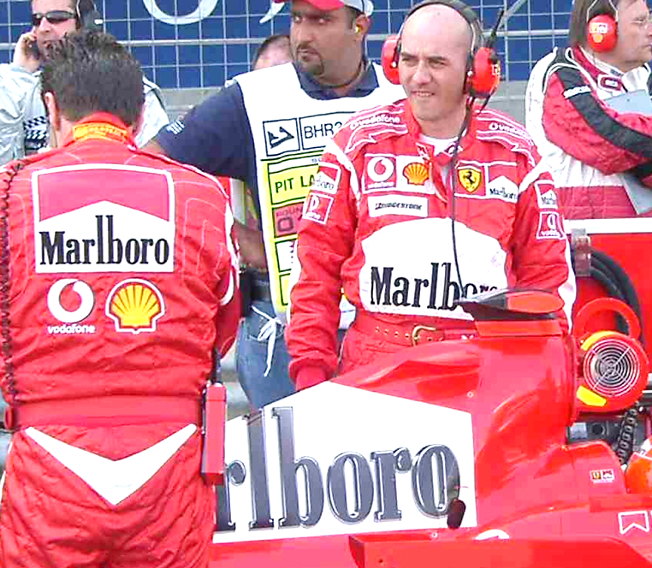
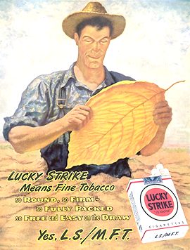
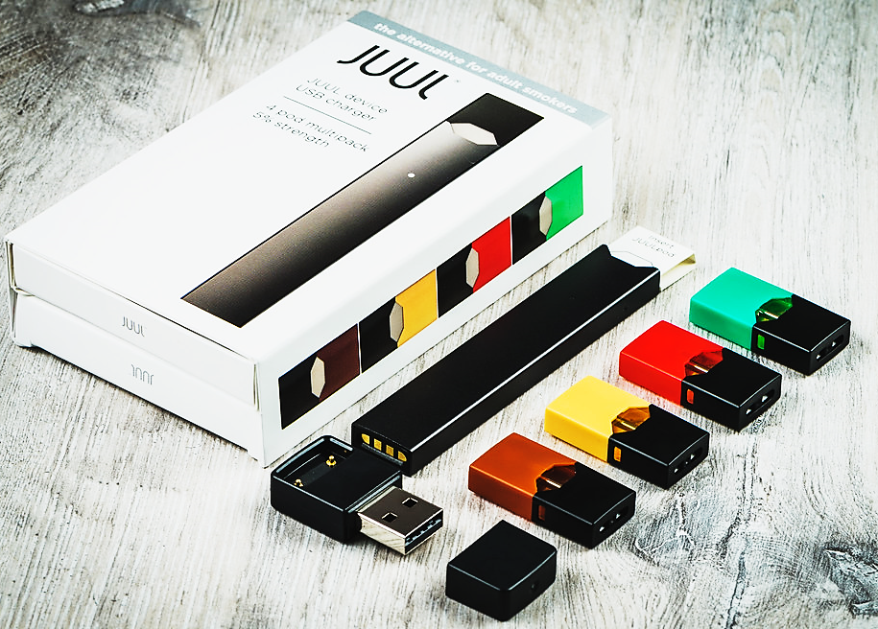
Notes:
The tobacco industry has always used several marketing strategies to hide the risks associated with cigarette use.
While promoting cigarettes (with actors hired by tobacco companies), campaigns sometimes targeted men, featuring them as cool and attractive. At times the focus was on women, featuring them as fashionable, modern and attractive. Later on, some ads were indirectly aimed at children and youth with images of cigarettes in cartoons. The industry was trying to hook youth as “Today’s teenager is tomorrow’s potential regular customer, and the overwhelming majority of smokers first begin to smoke while still in their teens.”
https://med.stanford.edu/tobaccopreventiontoolkit/E-Cigs.html
Arrival of JUUL in Canada in fall 2018
Like tobacco ads of the past, JUUL’s marketing campaigns present it as a trendy product, which helps to relax. Health Canada is concerned about the potential appeal of vaping products like JUUL to young people.
https://ici.radio-canada.ca/nouvelle/1123719/sante-cigarette-electronique-juul-canada-jeunes
(reference in french only)
Image sources: Pixabay and PowerPoint Clipart

Slide 3
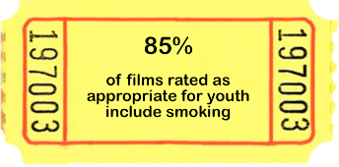
Today, advertising appears in films and on social media.
Notes:
The industry is adapting… now advertising appears in movies and on social media.
Image sources: PowerPoint Clipart and NB Anti-Tobacco Coalition
http://nbatc.ca/wp-content/uploads/2019/09/Movie-Influences-on-Tobacco-Use-in-Adolescents.pdf

Slide 4
Module 4
Legislation and Policies

Slide 5
Federal Government
Tobacco and Vaping Products Act
It is illegal to sell or
give vaping products
to persons under 18.
Notes:
Federal Legislation – Tobacco and Vaping Products Act
https://laws-lois.justice.gc.ca/eng/acts/t-11.5/FullText.html
In the vaping substances that contain nicotine, the level of nicotine can vary widely. Prior to July 2021 in Canada, vaping substance nicotine strengths ranged from 0 to over 60 mg/ml of nicotine. Since July 2021, the Nicotine Concentration in Vaping Products Regulations establish a maximum concentration of 20 mg/mL for vaping products manufactured in or imported into Canada. Legal vaping substances now contain 0 to 20 mg/ml of nicotine.
https://www.canada.ca/en/health-canada/services/smoking-tobacco/vaping.html
Image source: Pixabay

Slide 6
Provincial Government
Smoke-free Places Act
Use of e-cigarettes is prohibited wherever smoking is prohibited.
Tobacco and Electronic Cigarette Sales Act
It is illegal to sell electronic cigarettes and vaping liquids to persons under 19.
Persons under 19 may not enter a vape store unless accompanied by an adult.
Notes:
Smoke-free Places Act
https://www2.gnb.ca/content/gnb/en/departments/ocmoh/healthy_people/content/LivingTobaccoFree/legislation.html
Tobacco and Electronic Cigarette Sales Act
http://laws.gnb.ca/en/ShowPdf/cs/T-6.1.pdf
Since September 1, 2021:
Flavoured e-cigarettes, except for tobacco flavour, are no longer be permitted to be sold.
Flavoured substances, except for tobacco flavour, meant to be added to e-cigarettes are no longer be permitted to be sold.
https://www2.gnb.ca/content/gnb/en/departments/ocmoh/healthy_people/content/LivingTobaccoFree/legislation.html
Image source: PowerPoint Clipart

Slide 7
School Policy
Policy 702: Tobacco-Free Schools
Use of tobacco, including e-cigarettes is prohibited at all times:
On public school premises
In school vehicles
In vehicles on school premises
Notes:
Policy 702: Tobacco-Free Schools
https://www2.gnb.ca/content/dam/gnb/Departments/ed/pdf/K12/policies-politiques/e/702A.pdf
Image source: PowerPoint Clipart

Slide 8
Test your
knowledge!

Slide 9
True or false?
Vape shops may display advertisements outside their place of business.
Notes:
Image source: Pixabay

Slide 10
FALSE
Outdoor advertisement by vape shops is illegal and promotional material inside these shops must not be visible from the outside.
Notes:
Answer:
False
Outdoor advertisement by vape shops is illegal and promotional material inside these shops must not be visible from the outside.
https://www2.gnb.ca/content/gnb/en/departments/ocmoh/healthy_people/content/LivingTobaccoFree.html
Image source: Pixabay

Slide 11
True or false?
It is illegal to purchase an e-cigarette for someone under 19.
True
Notes:
Answer:
True
In New Brunswick, it is illegal for anyone to purchase or attempt to purchase tobacco, smoking supplies or electronic cigarettes for a person under 19.
https://www2.gnb.ca/content/gnb/en/departments/ocmoh/healthy_people/content/LivingTobaccoFree.html
Image source: Pixabay

Slide 12
Multiple choice
Which of the following statements is true?
I have the right to vape in the school yard.
It is illegal to vape where smoking is prohibited.
An adult may vape in their own vehicle on school property.
Notes:
Answer:
b.
The use of e-cigarettes is prohibited wherever smoking is prohibited.
https://www2.gnb.ca/content/gnb/en/departments/ocmoh/healthy_people/content/LivingTobaccoFree.html
Image source: Pixabay

Slide 13
Discussion
Notes:
We suggest that you engage in a dialogue on the topics covered in this module and to encourage students to actively participate in group discussions.
Image source: Pixabay

Slide 14
Module 5
Refusal Strategies

Slide 15
How to say NO?
Notes:
It’s not easy to say no and express your opinion, especially when it differs from what others think. We get stuck between the desire to respect our opinions and the fear of rejection. Pressure can become really strong.
Here are some tips for saying no:
https://commencepasafumer.ca/en
Image source: Adobe Stock (purchase)

Slide 16
No thanks,
I don’t vape!
If you vape, you’re three times more likely to try smoking.
Not vaping saves me money!
Notes:
Refuse:
“No thanks, I don’t vape!”
Use humour:
“Not vaping saves me money!”
Share your knowledge:
“If you vape, you’re three times more likely to try smoking.”
https://avoidthetrap.ca/
https://commencepasafumer.ca/en
https://www.gov.mb.ca/health/tobacco/docs/bot/gr6.pdf
Image source: Pixabay

Slide 17
Why do you vape?
No thanks! I have to go.
Notes:
Answer with a question:
If someone offers you a vape, ask them: “Why do you vape anyway?” This forces them to justify their action and may encourage them to think about it.
Find an excuse or leave:
Find a temporary excuse without clearly expressing your disagreement.
Leave while saying: “No thanks! I have to go.”
Delay the decision:
“Not now.”
“We’ll talk about it later.”
https://avoidthetrap.ca/
https://commencepasafumer.ca/en
https://www.gov.mb.ca/health/tobacco/docs/bot/gr6.pdf
Image source: Pixabay

Slide 18
NO!
Come on, we’re going to play hockey.
No thanks!
No thanks!
No thanks!
Notes:
Change the subject:
Your friend suggests that you try their new e-cigarette.
“No! Come on, we’re going to play hockey.”
Use the broken record technique:
To every question, answer the same thing.
“You want an e-cigarette?”
“No thanks.”
“Come on!”
“No thanks.”
“Are you afraid, is that it?”
“No thanks.”
If the person doesn’t get it, leave.
https://avoidthetrap.ca/
https://commencepasafumer.ca/en
https://www.gov.mb.ca/health/tobacco/docs/bot/gr6.pdf
Image source: Pixabay

Slide 19
No thanks! Does this mean I have to vape to be your friend?
Simply ignore the other person.
Notes:
Reverse the pressure:
“No thanks! Does this mean I have to vape to be your friend?”
Ignore the other person:
Just simply ignore the other person. Continue doing what you were doing or leave without saying a word.
Avoid the situation:
A friend who vapes invites you over.
It will just be the two of you. If you don’t feel comfortable, turn down the invitation.
https://avoidthetrap.ca/
https://commencepasafumer.ca/en
https://www.gov.mb.ca/health/tobacco/docs/bot/gr6.pdf
Image source: Pixabay

Slide 20
Make friends with people who have the same interests as you. It’s easier to say no when our friends have the same opinion.
Notes:
Strength in numbers:
Being in a group with several people who don’t vape increases the ability to resist peer pressure from others.
Sometimes, the only way to have respect for your choices and opinions is to change your group of friends.
https://avoidthetrap.ca/
https://commencepasafumer.ca/en
https://www.gov.mb.ca/health/tobacco/docs/bot/gr6.pdf
Image source: Pixabay

Slide 21
CHOOSE the right path for your HEALTH!
Notes:
Image source: Adobe Stock (purchase)

Slide 22
It’s up to YOU to make the right CHOICE!
Notes:
Resources
Consider the consequences of vaping, Health Canada
https://www.canada.ca/en/services/health/campaigns/vaping.html
Health Canada
https://www.canada.ca/en/health-canada/services/smoking-tobacco/vaping.html
NB Anti-Tobacco Coalition
http://www.nbatc.ca/en/index.php?page=e-cigs-vaping-products-flavouredtobacco
New Brunswick Lung Association
https://nb.lung.ca
Campaign to prevent vaping (Quebec)
https://avoidthetrap.ca/
https://commencepasafumer.ca/en
Tobacco Education for Manitoba Students
https://www.gov.mb.ca/health/tobacco/bot.html
Image source: Adobe Stock (purchase)

